Slide 1
Lesson 10
Projects in Python

Slide 2
Make sure to have PyCharm open
If you were not able to install it yet, then watch last week’s lesson video. For now, you can code in the web browser using this link:
https://www.programiz.com/python-programming/online-compiler/

Slide 3

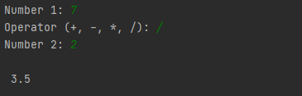
Project 1: Calculator
Create a calculator using arithmetic operators and functions.
Should have addition, subtraction, multiplication, division functions
Depending on which function is called it should be able to take numbers and calculate
Bonus #1! If you can try to make functions that will do floor division.
Bonus #2! Try making another function for determining even or odd.
Input
Possible Input & Output:
Output

Slide 4

Project 2: Rock Paper Scissors
Create a Rock-Paper-Scissors game where you play against the computer.
Take an input from the user on which they pick. Rock beats scissors, paper beats rock, and scissors beats paper. If both choose the same, then it is a tie.
Hint: you can get a random integer by typing import random to import the library, and then use the command random.randint(x, y) to get a random number from x - y (not including x). You can then have it act as a random choice - 1 may be the computer choosing rock, 2 may be the computer choosing paper, etc.
Possible Input & Output:
Input
Output

Slide 5
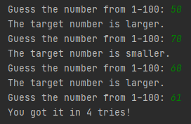
Project 3: Number Guesser
Create a Number Guessing Game where the user has to try and get a target number. First, the computer generates a random number from 1-100. Then, the player enters a number to start, and the computer will tell whether that number is less or more than the target. This repeats until the target number is reached. Essentially:
Generate a random number from 1-100
Keep asking for inputs until the correct guess
Keep track of the amount of attempts
Inputs
Outputs
Possible Input & Output:

